Slide 1

Cloud penetration testing
by Steven H.

Slide 2
#1 Public exposed storage Cloud storage configured to be publicly accessible
Azure Blob Storage
[storage-acct-name].blob.core.windows.net
[storage-acct-name].file.core.windows.net
AWS Buckets
https://[bucketname].s3.amazonaws.com
https://github.com/initstring/cloud_enum
Notes:
Predictable DNS leads to subdomain enumeration

Slide 3
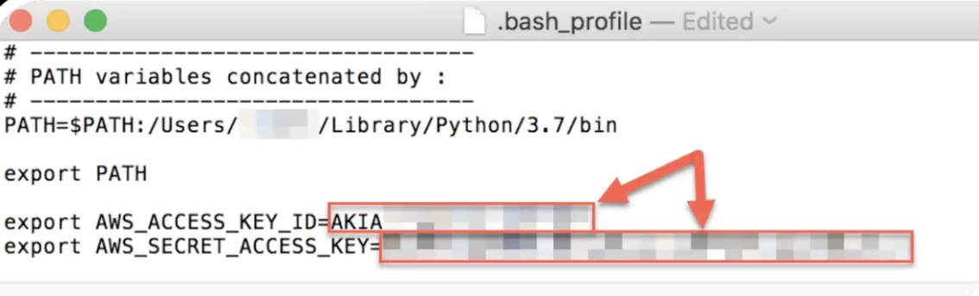
#2 Key disclosure in repositories
Tools
https://github.com/gitleaks/gitleaks
Secrets often get published to code repositories ⟶ GitHub
https://github.com/N0MoreSecr3ts/wraith
https://github.com/trufflesecurity/trufflehog
Find keys in public and private repositories
Search through entire commit history

Slide 4
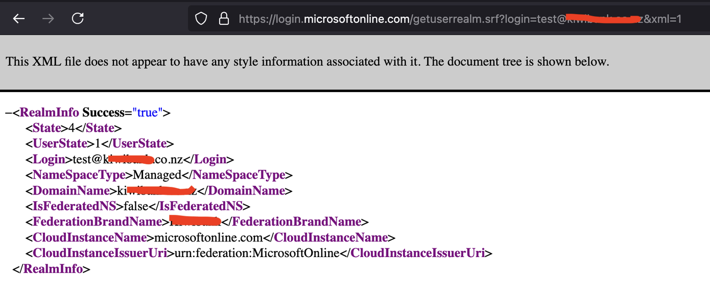
#3 Weak Password Policies
IDENTITY MICROSOFT 365 USAGE
https://login.microsoftonline.com/getuserrealm.srf?login=username@company&xml=1
https://login.microsoftonline.com/<tenant>/v2.0/.well-known-openid-configuration

Slide 5
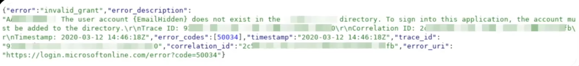
#3 Weak Password Policies
USER ENUMERATION
User enumeration on Azure can be performed at https://login.microsoft.com/{tenant-id}/oath2/token
Detect invalid users while password spraying https://github.com/dafthack/MSOLSpray
Enumerate users via OneDrive https://github.com/nyxgeek/onedrive_user_enum

Slide 6
#3 Weak Password Policies
PASSWORD ATTACKS / SPRAYING
Trying one password for every user at an org to avoid account lockouts.
Most systems have some sort of lockout policy.
Example: 5 attempts in 30 mins = lockout.
If we attempt to auth as each individual username one time every 30 mins we lockout nobody

Slide 7
#3 Weak Password Policies
PASSWORD PROTECTION & SMART LOCKOUT
Azure Password Portection
Prevents users from picking passwords with certain words like seasons, company name, etc.
Azure Smart Lockout
Locks out auth attempts whenever brute force or spray attempts are detected
Can be bypassed with FireProx + MSOLSpray https://github.com/ustayready/fireprox

Slide 8
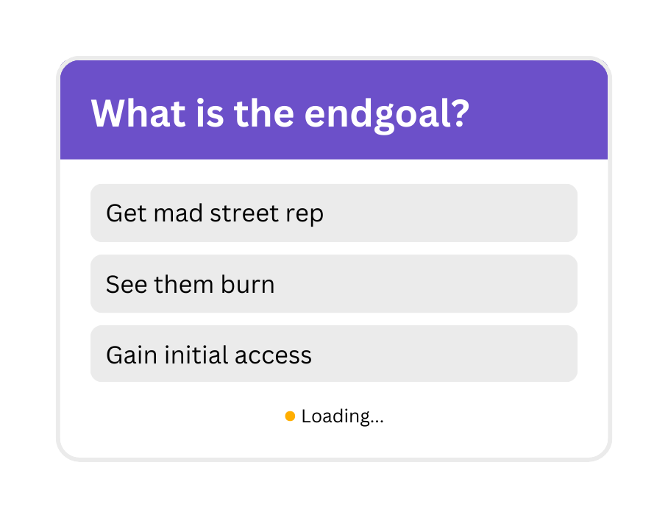


Endgoal of attacks

Slide 9



Gaining access
Misonconfigurations and exposed secrets
EXTERNAL
INTERNAL (RESOURCES)
INTERNAL (API ACCESS)
Unauthenticated
Attacking public resources
Testing internal cloud resources from another resource such as a VM
Authenticated
Identify vulnerabilities via API calls & configuration analysis

Slide 10
KEY DISCOSLURE IN REPOSITORIES
Methods to gain access
Look out for the red security notification in Github when it lights up. Don’t ignore GHAS warnings. Ask for InfoSec guidance. Remove historical Git commits containing these.
PASSWORD ATTACKS
Be encouraged to try it out. See what you find and rotate. Rotate often, automatically. User password managers. Don’t store secrets in environment variables for Lambda functions.
PHISHING
Hit that report phish button in mails. Rotate access keys. Lookout for fishy temporary credentials.
REMOTE CODE EXECUTION
Also known as getting a foothold.
Patch your stuff. Utilize Azure Security Center and AWS SecurityHub for prioritization.
Notes:
Related to phishing: https://thehackernews.com/2025/03/hackers-exploit-aws-misconfigurations.html
Related to RCE for AWS: https://aws.amazon.com/solutions/guidance/threat-and-vulnerability-management-on-aws/

Slide 11
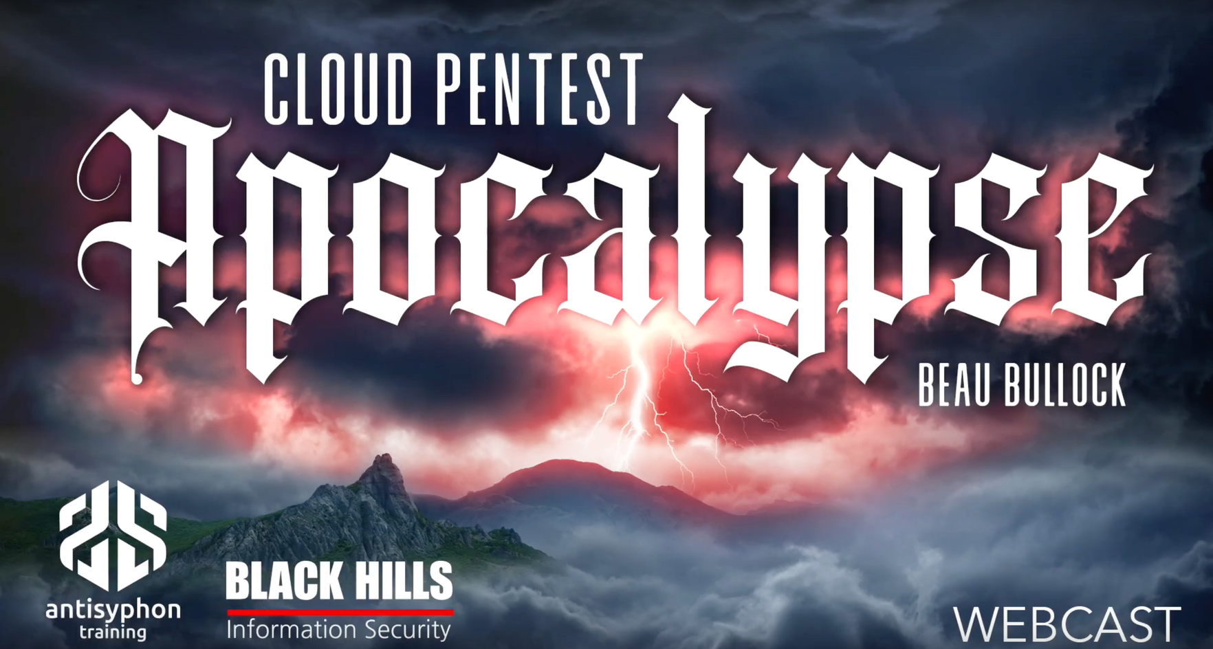

Credits
Beau’s website:
https://www.breakforge.io/
Antisyphon Training:
Securing Cloud
Breaching Cloud
Defending M365 & Azure
Red Team Initial Access
GitHub Resources:
dafthack/CloudPentestCheatsheets
dirkjanm/ROADtools
NetSPI/MicroBurst
prowler-cloud/prowler
BloodHoundAD/AzureHound
nccgroup/ScoutSuite
Gerenios/AADInternals

Slide 12

Do you have
any questions?
Send it to us! We hope you learned something new.

